Slide 1

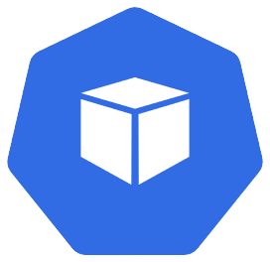
Deploying The App Part 1 – Target State
Azure
Kubernetes
deployment
deployment
data-api
mongodb
pod
pod
data-api-{random-string}
mongodb-{random-string}

Slide 2
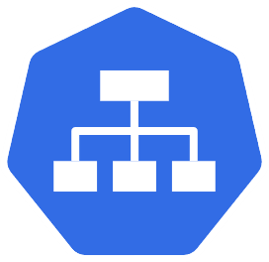




Basic Networking – Target State
Azure
Kubernetes
Service (ClusterIP)
pods
deployment
database
mongodb
port:27017
MongoDB connection/traffic
pods
Service (LoadBalancer)
Load Balancer
deployment
port:80
Public IP for
data-api
HTTP traffic from internet
data-api
data-api
port:4000

Slide 3
Adding The Frontend – Target State
Azure
Kubernetes
Service (LoadBalancer)
pod
deployment
port:80
mongodb
Load
Balancer
frontend
port:3000
frontend
Public IP for
frontend
deployment
HTTP traffic from internet
data-api
deployment
pods
port:
27017
Service
Public IP for
data-api
port:80
Service (LoadBalancer)
data-api
port:4000
database
MongoDB connection/traffic

Slide 4


Final Application State
Azure
Kubernetes
serviceName:frontend
service
pod
port:80
Load
Balancer
service
nginx
ingress
frontend
port:3000
data-api
Public IP for
ingress
HTTP traffic from internet
ingress controller
port:4000
pods
port:80
serviceName:data-api
service
MongoDB traffic
service
port:
27017
secret
pod
mongo-creds
database
mongodb

Slide 5
OLD

Slide 6
Deploy MongoDB – Architecture
Azure
Kubernetes
deployment
orders-mongo-mongodb
service
pod
orders-mongo-mongodb
orders-mongo-mongodb-{random-string}
secret
mongodb

Slide 7
Deploy the Order Capture API – Architecture
Azure
Kubernetes
orders-mongo-mongodb
Service (ClusterIP)
orders-mongo-mongodb.default.svc.cluster.local
pods
MongoDB connection/traffic
Service (LoadBalancer)
Load Balancer
deployment
port:80
Public IP for
captureorder
captureorder
captureorder
HTTP traffic from internet
port:8080
secret
mongodb

Slide 8
Deploy the Frontend Using Ingress – Architecture
Azure
Kubernetes
secret
orders-mongo-mongodb
mongodb
Public IP for
captureorder service
HTTP traffic from internet
pods
deployment
Load Balancer
service
captureorder
HTTP traffic from internet via ingress
frontend.12.34.56.78.nip.io
Public IP for
Ingress controller
service
ingress
service
deployment
ingress controller
serviceName:frontend
frontend
frontend

Slide 9


Enable SSL/TLS on Ingress – Architecture
Azure
secret
Kubernetes
orders-mongo-mongodb
clusterissuer
mongodb
tls-secret
cert
serviceName:captureorder
pods
frontend.12.34.56.78.nip.io
deployment
orders.12.34.56.78.nip.io
ingress
Load Balancer
service
service
captureorder
Public IP for
Ingress controller
ingress controller
ingress
service
deployment
HTTP traffic from internet via ingress
serviceName:frontend
frontend
frontend

Slide 10

Kubernetes Ingress – Simple Architecture
Azure
Kubernetes
rules:
- host: foo.example.net
Foo
pods
Type: LoadBalancer
ingress
service
Load Balancer
service
Type: ClusterIP
Public IP for
Ingress controller
ingress controller
Bar
ingress
pods
Public DNS
bar.example.net
foo.example.net
Both point to public IP
of the ingress controller
rules:
- host: bar.example.net
service
Type: ClusterIP

